Slide 1
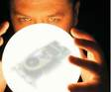
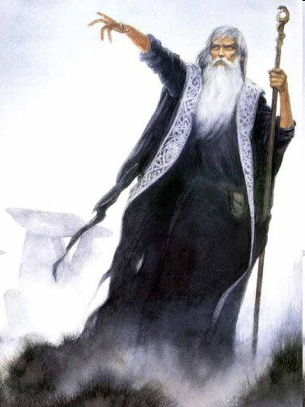


Prediction of Complex Traits in Animal Breeding:
From Henderson to Bayesian Machine Learning
Daniel Gianola
Sewall Wright Emeritus Professor
of Animal Breeding and Genetics
University of Wisconsin
Dairy Science

Slide 2
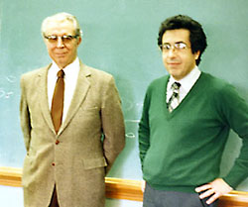
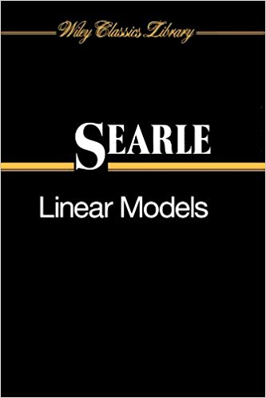
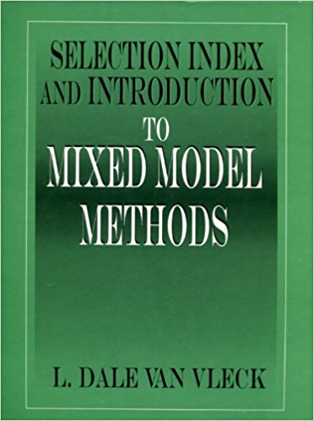
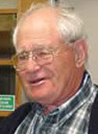
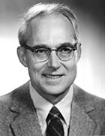
CRH and DG
Urbana, 1987

Slide 3
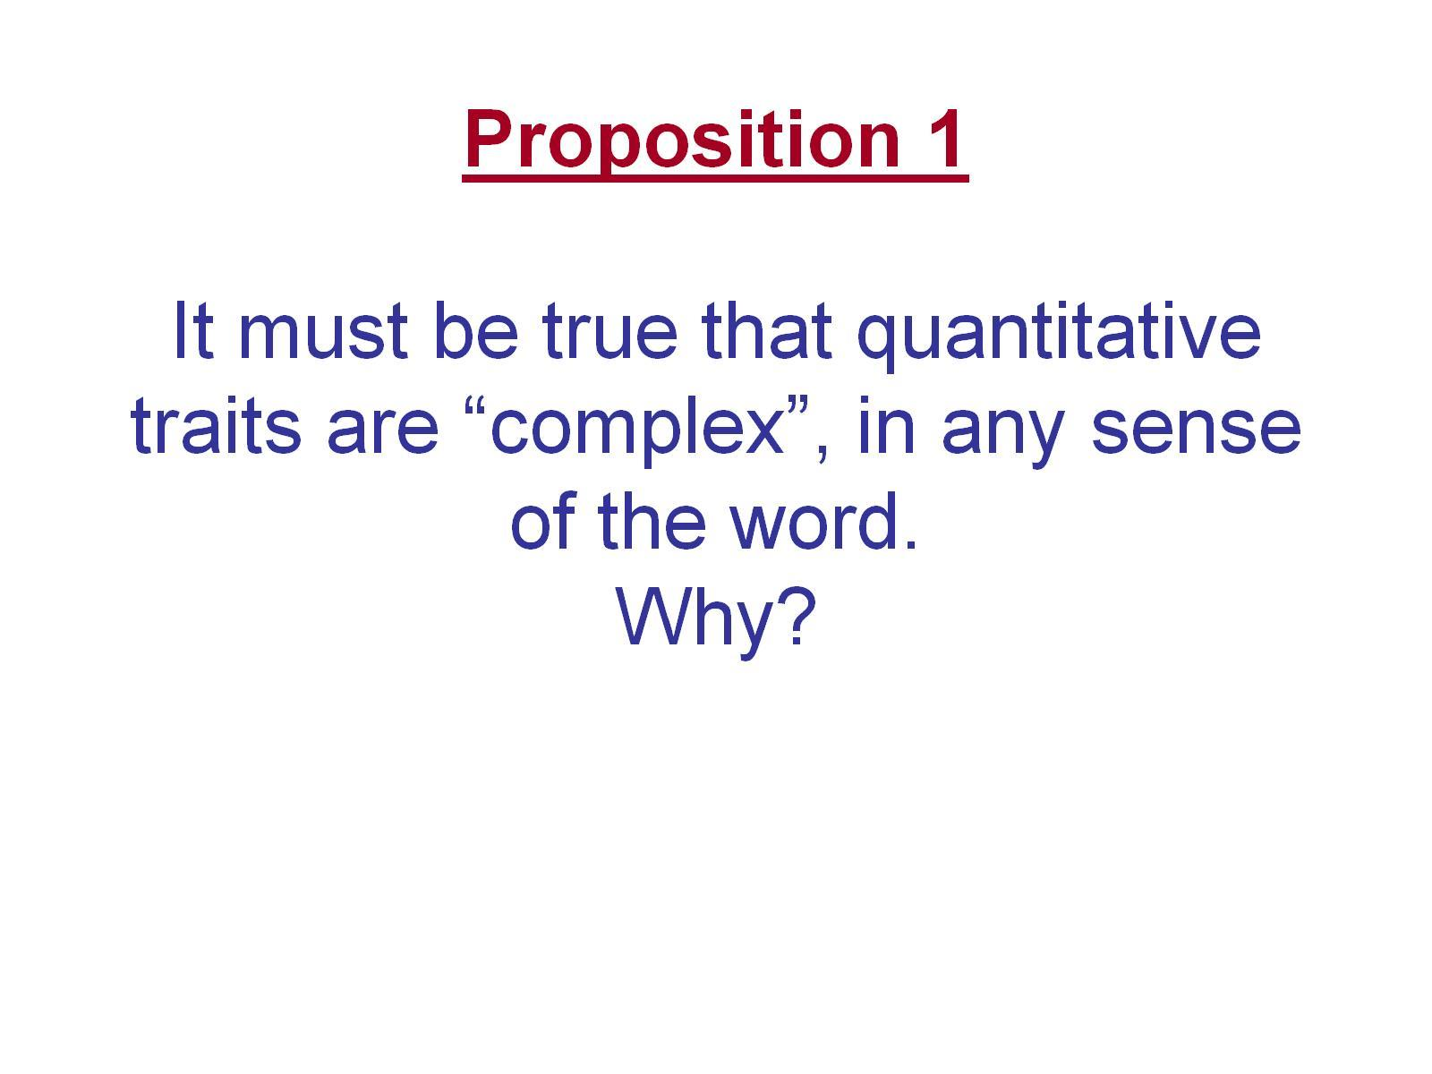
Proposition 1 It must be true that quantitative traits are “complex”, in any sense of the word. Why?

Slide 4
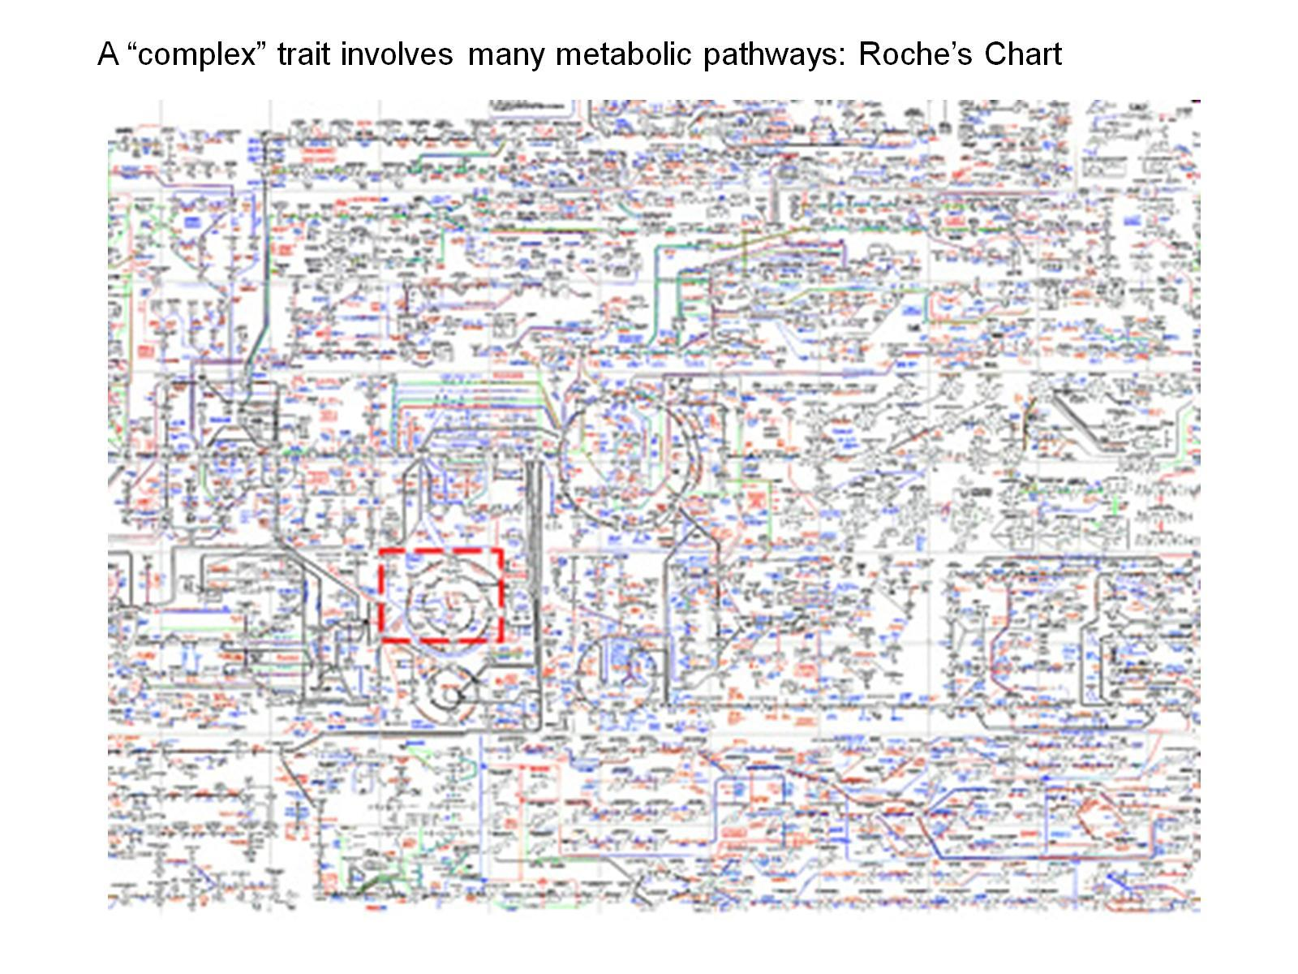

Slide 5
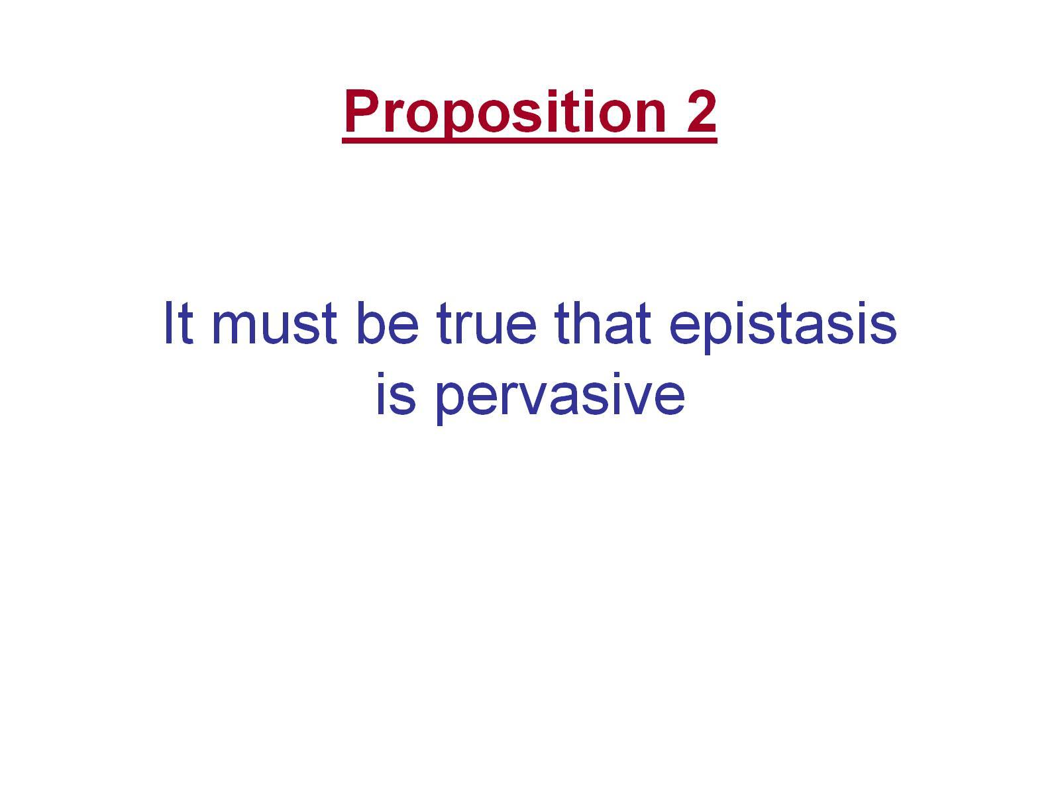
Proposition 2 It must be true that epistasis is pervasive

Slide 6
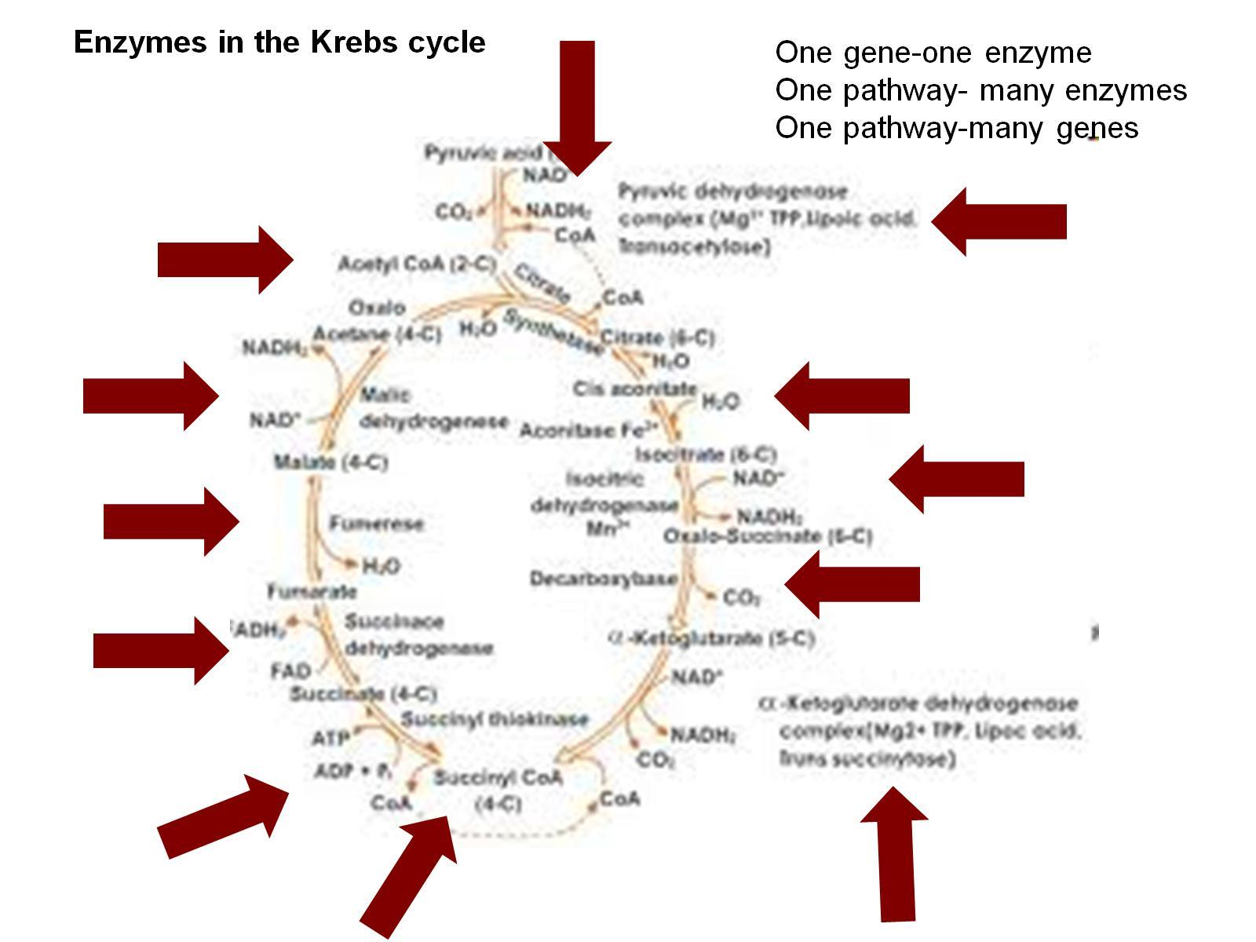

Slide 7
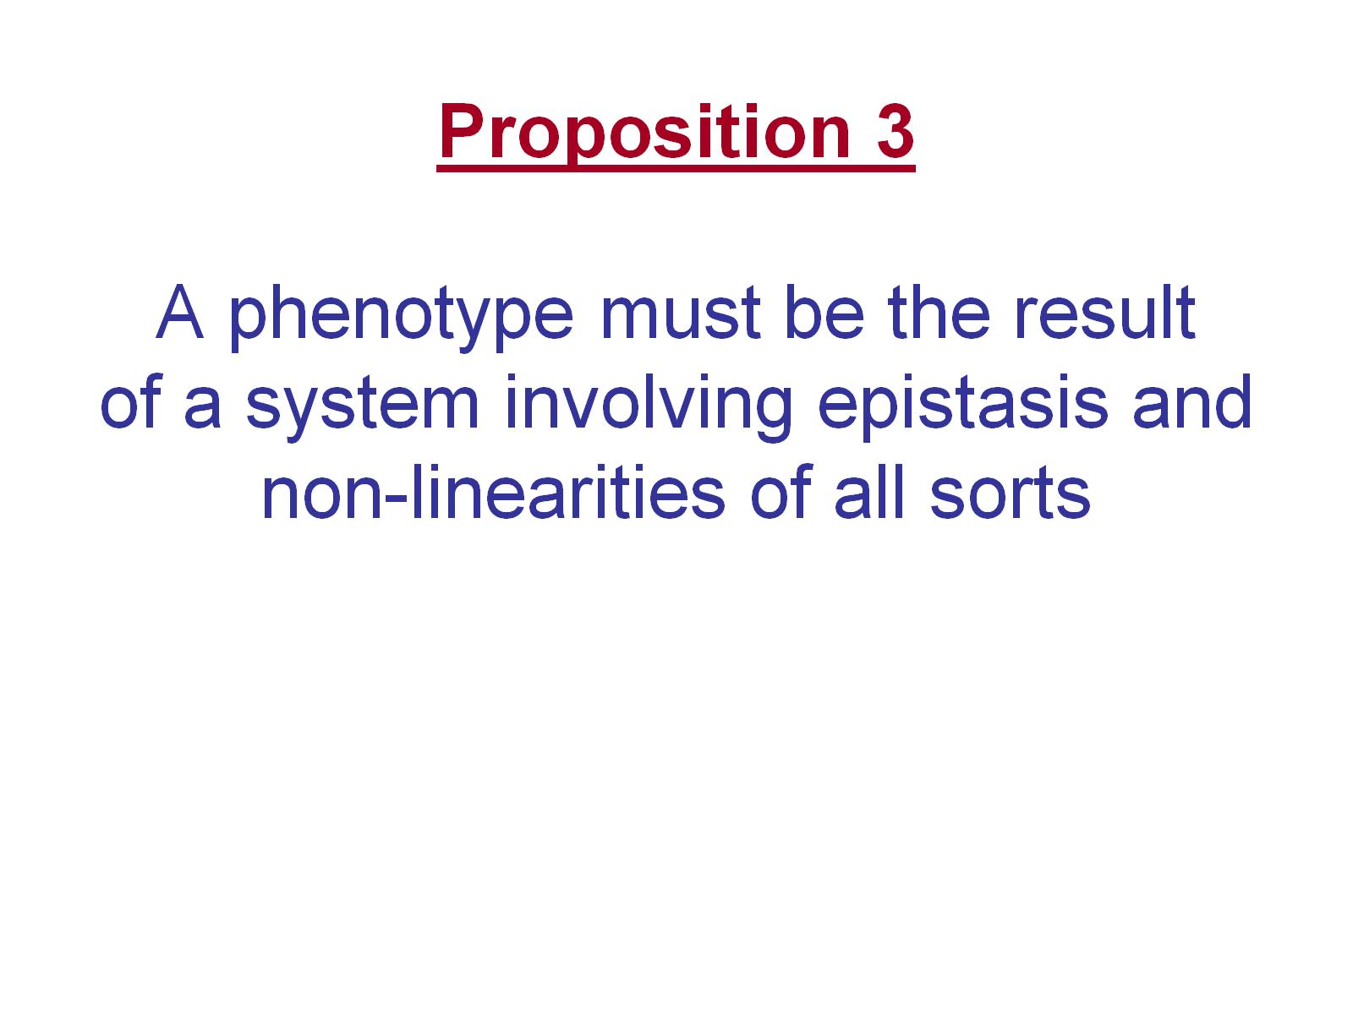
Proposition 3 A phenotype must be the result of a system involving epistasis and non-linearities of all sorts

Slide 8
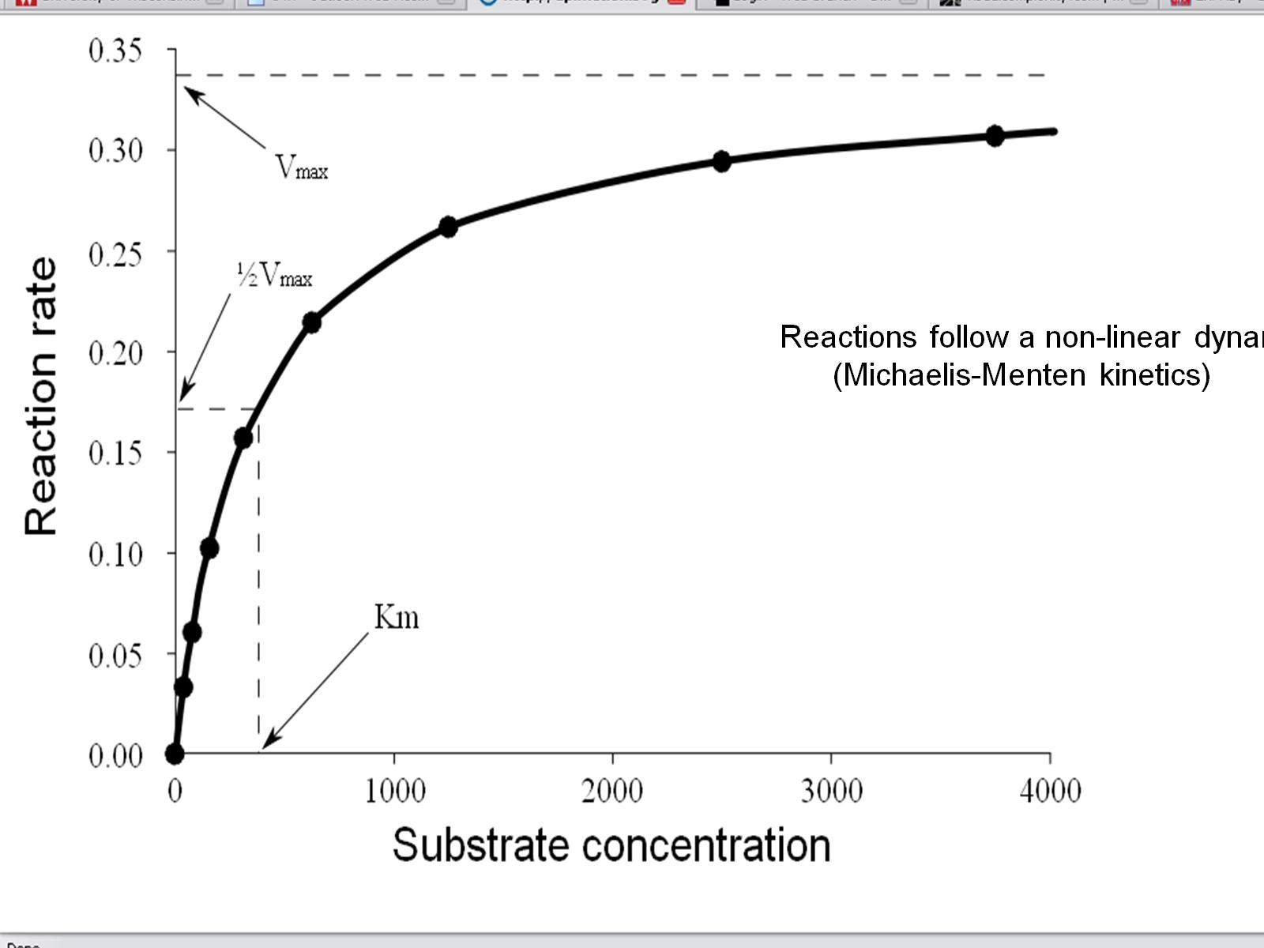

Slide 9
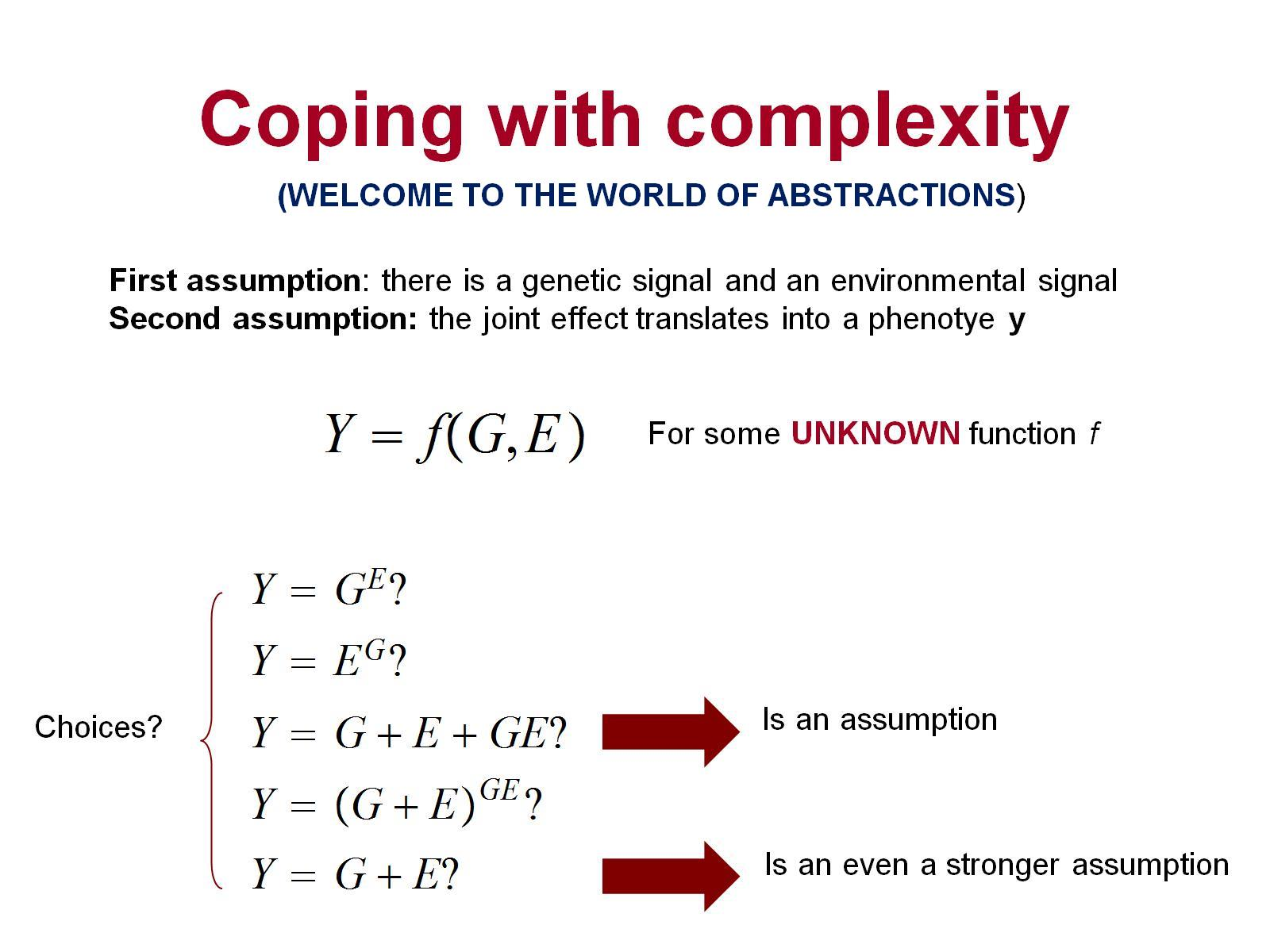
Coping with complexity

Slide 10
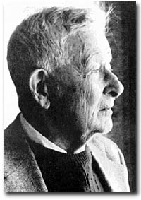
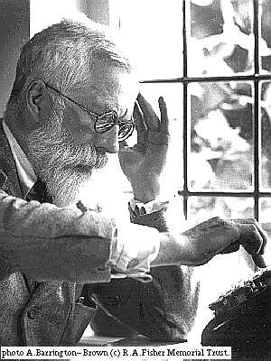
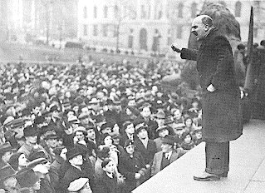
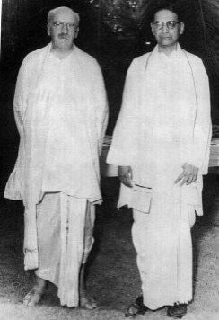
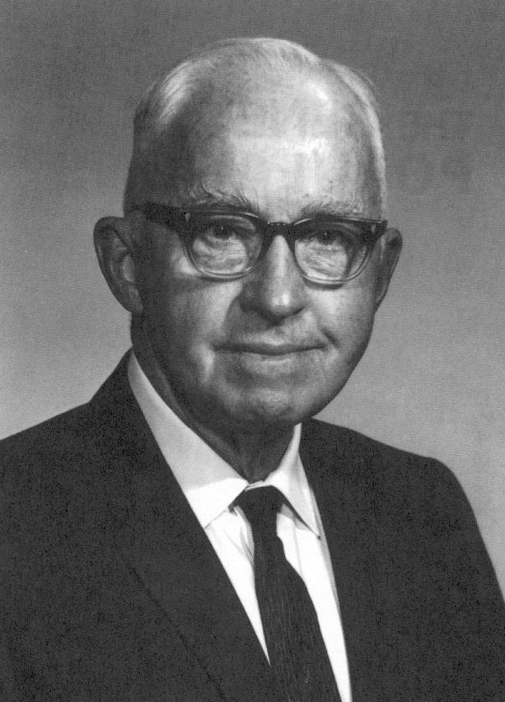
Sewall Wright
R. A. Fisher
J. B. S. Haldane
FOUNDERS OF MODERN QUANTITATIVE
AND POPULATION GENETICS
Jay L. Lush, Iowa State University
(animal breeding)
SCIENTIFIC FOUNDATIONS OF
ANIMAL (PLANT) BREEDING

Slide 11
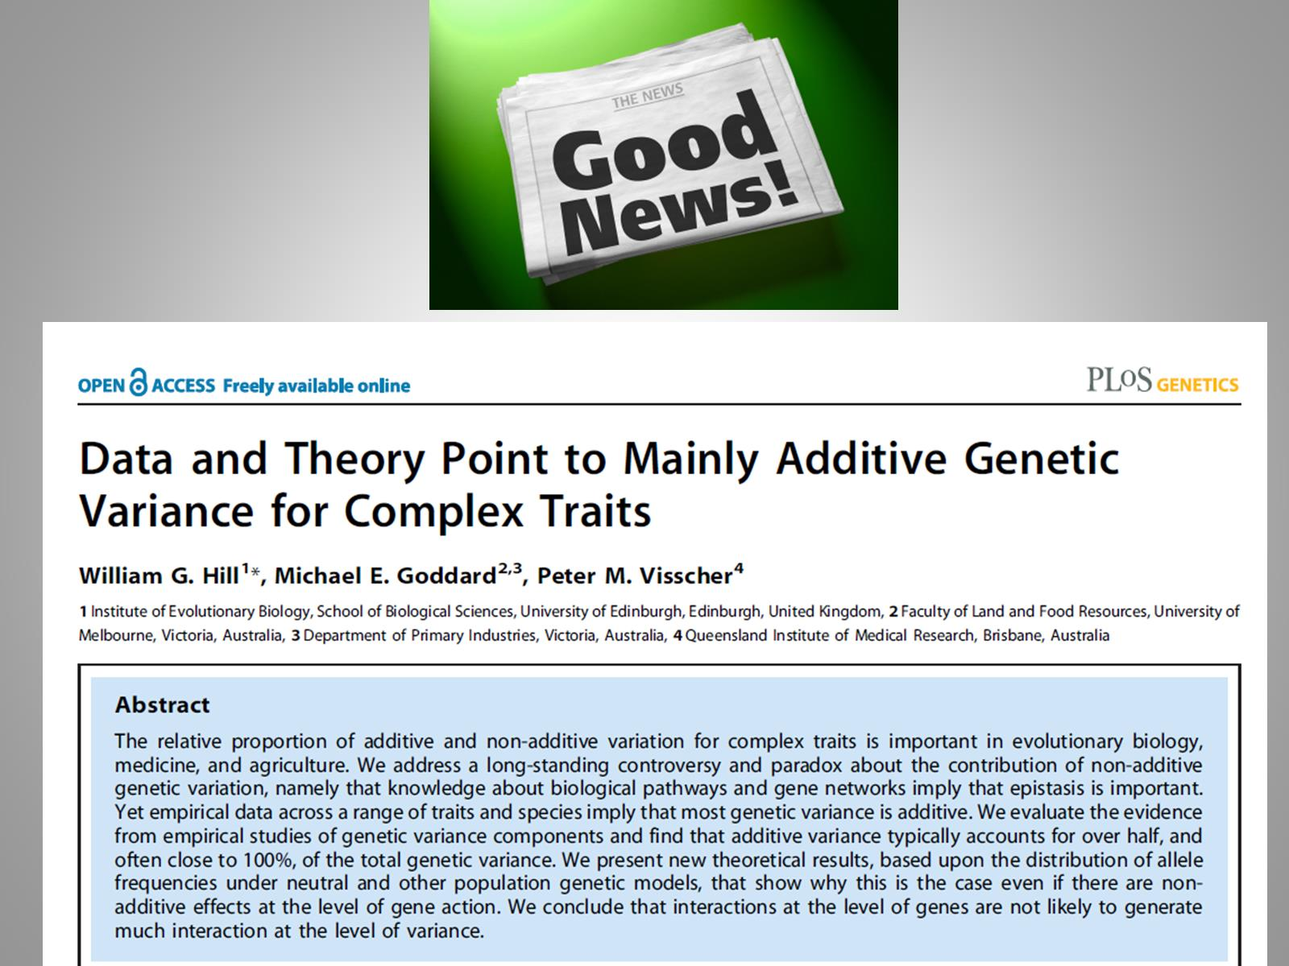
(FISHER’S INFINITESIMAL
MODEL USEFUL FOR
DESCRIPTION, PREDICTION, BREEDING)

Slide 12
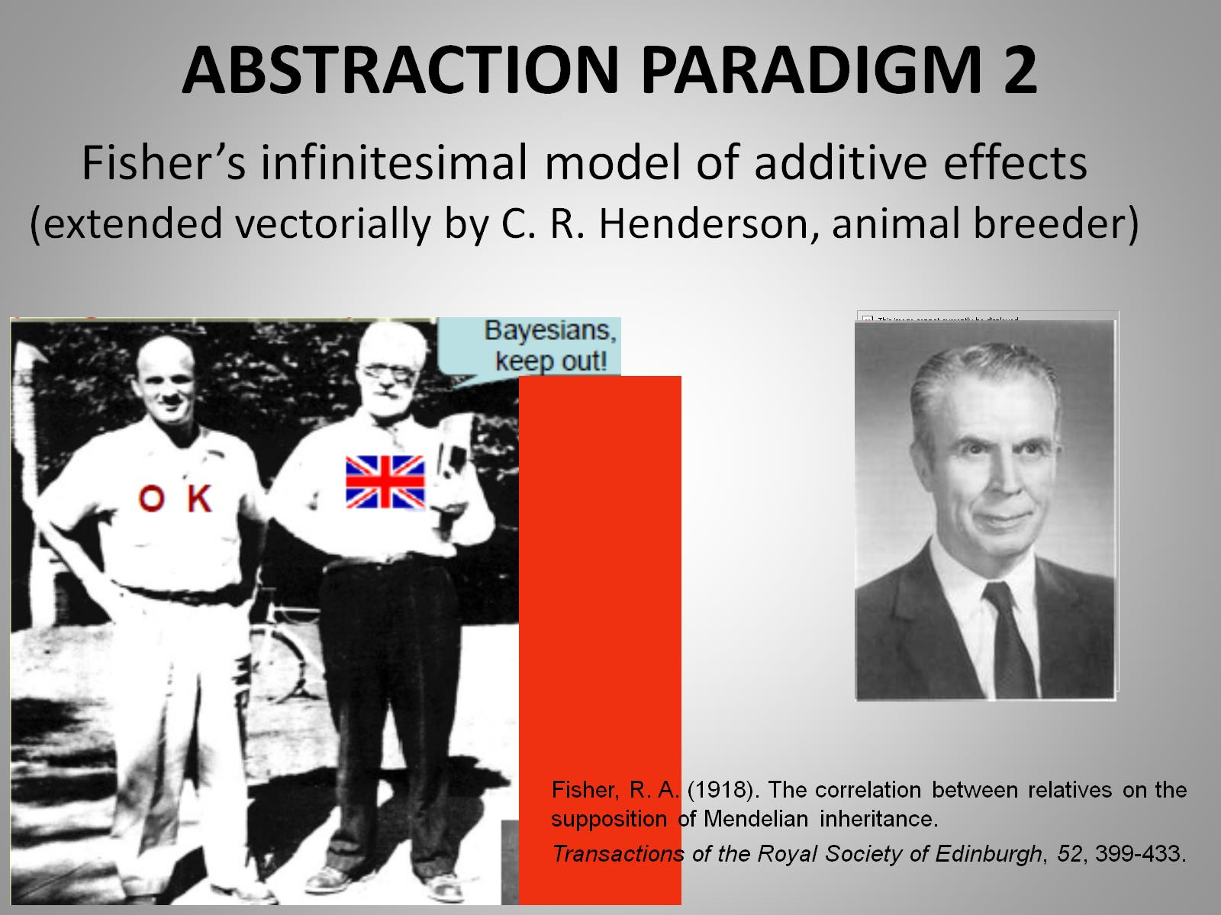
ABSTRACTION PARADIGM 2
FROM FISHER TO HENDERSON (CRH)
Fisher’s mean became a mean vector; additive variance became a covariance matrix
BLUP and mixed model equations developed
Wright’s genealogy matrix found to have easy inverse by CRH
BLUP extended to cross-sectional, longitudinal and multivariate data
BLUP for non-existing individuals…
More efficient production of milk, meat, eggs and fiber!

Slide 13
BLUP=Exactly like the Holy Roman Empire (Gelman)
THE n<<p ERA (in animal breeding, began in 1948-1973: C. R. HENDERSON)
Fixed Random
BLUP=Best linear unbiased predictor
BLUP= Conditional posterior mean in Bayes Gaussian linear hierarchical model
BLUP=penalized (L2) maximum likelihood
BLUP=Similar to kriging in geostatistics
BLUP=special case of RKHS regression

Slide 14
WHY BLUP?
FLEXIBLE
AMENDABLE
WELL UNDERSTOOD
FEASIBLE (250 million equations)
UNPRETENTIOUS
OUTPUTS EASY TO EXPLAIN
“UNBIASEDNESS” MISUNDERSTOOD AND OVERSOLD IN ANIMAL BREEDING

Slide 15
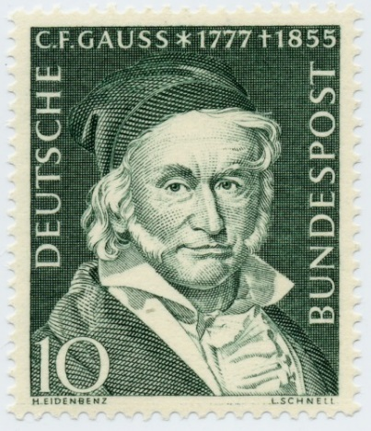

Remember that you must assume me!
Robin Thompson
(REML, 1971)

Slide 16
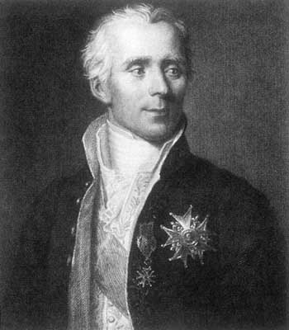
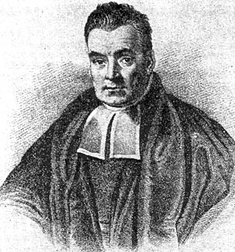
BAYESIAN INFERENCE AND THE NEO-BAYES-LAPLACE REVOLUTION (James-Stein, Lindley, Box, Zellner…)
Rev. Thomas Bayes
1702 London, England 1761 Tunbridge Wells, Kent, England
1763. “An essay towards solving a problem in the doctrine of chances”. Philosophical Transactions of the Royal Society of London 53, 370-418.
Pierre-Simon Laplace
1749 Beaumont-en-Auge, France 1827 Paris, France
1774. "Mémoire sur la probabilité des causes par les événements“. Savants étranges 6, 621-656. Oeuvres 8, 27-65

Slide 17
FROM HENDERSON TO BAYES
PRE-MCMC
Gianola, D., Foulley, J.L. Non-linear prediction of latent genetic liability with binary expression: an empirical Bayes approach. in: Proc. 2nd World Congr. Genet. Appl. Livest. Prod. VII. ; 1982:293–303.
Gianola, D., Foulley, J.L. Non-linear prediction of latent genetic liability with binary expression: an empirical Bayes approach. in: Proc. 2nd World Congr. Genet. Appl. Livest. Prod. VII. ; 1982: 293–303.
MCMC
“Gibbs for pigs” (1993)
MCMC WITH MARKER DATA
GENOMIC SELECTION

Slide 18
Bayesian methods in Genetics: today
-Classification of genotypes
-Molecular evolution
-Linkage mapping
-QTL cartography
-Genetic risk analysis
-Gaussian linear and non-linear models
: cross-sectional+ longitudinal univariate+ multivariate
-Generalized linear models
-Survival analysis
-Thick-tailed processes
-Mixtures
-Semi-parametrics
-Transcriptional analysis
-Structural equation modeling
-Bayesian proteomics with wavelets
-Bayesian non-parametrics (Dirichlet process priors)
-EPITOME: Methods for genomic selection
(the Bayesian Alphabet—A, B, C,C-pi, L,R… and more)
RED: animal breeders
made strong contributions

Slide 19
THE GENOMIC ERA

Slide 20
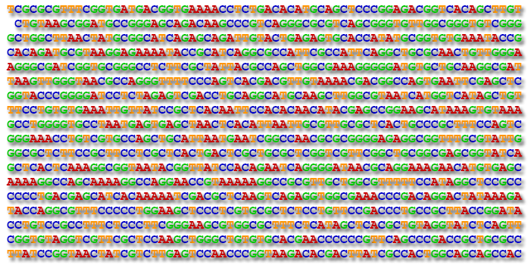
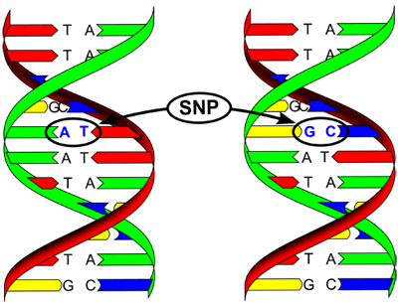
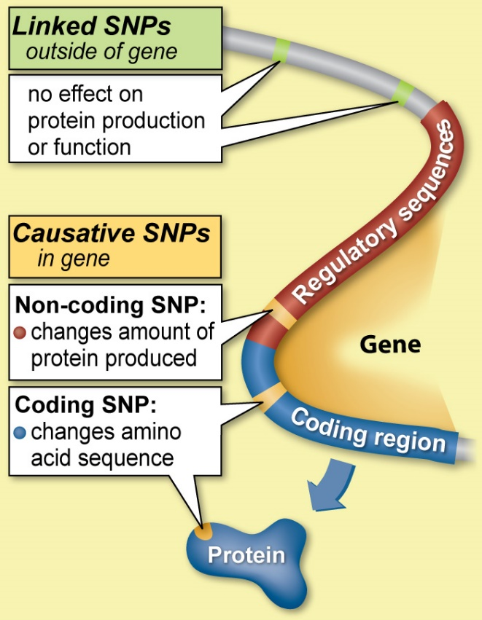
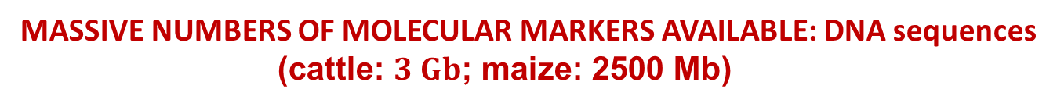
MASSIVE NUMBERS OF MOLECULAR MARKERS AVAILABLE: DNA sequences
(cattle: $3 Gb$; maize: 2500 Mb)

Slide 21
WIGGANS (2017), Ann. Reviews of Animal Biosciences

Slide 22
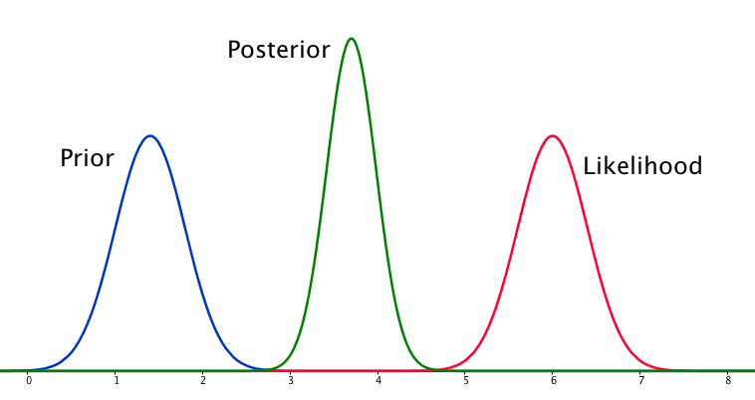
DIGRESSION ON BAYESIAN LEARNING
“Bayesians address the question everyone is interested in,
by using assumptions no-one believes”
Lyons (2007, Oxford)
Where
Am I?
Come here!
Come here!
Quest for “good priors ? “Objective” Bayesians search for bad priors
Want to learn, i.e., get away from prior
IMPORTANT: MEASURING EXTENT OF BAYESIAN LEARNING
(only one serious attempt in QG literature)

Slide 23
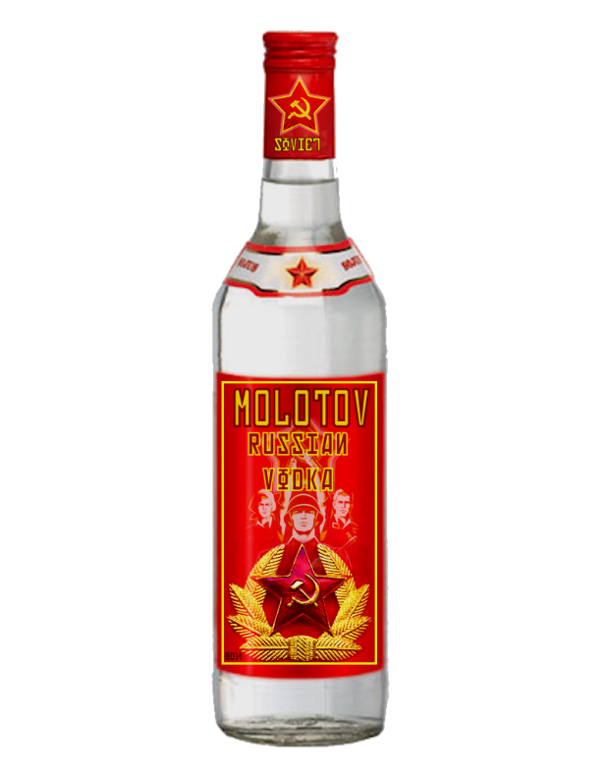
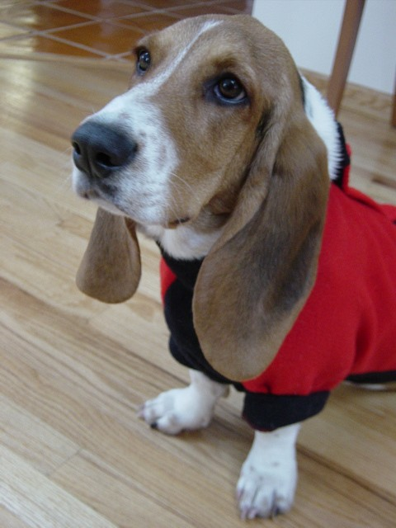

MCMC FOR BAYESIAN INFERENCE
EXTRAVAGANT PRIORS coming out of the blue…
Great! No limits to imagination!
e.g., Bayes GRRR%##@*#
DATA
POSTERIOR
PRIOR

Slide 24
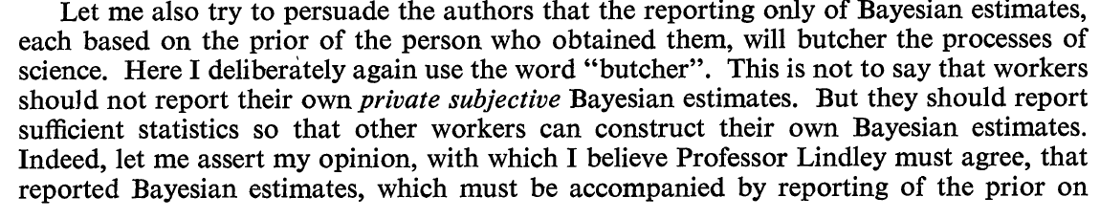
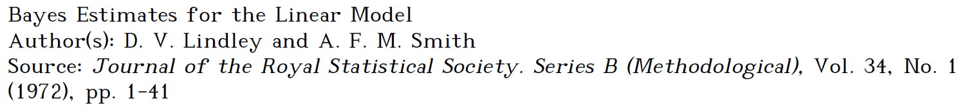
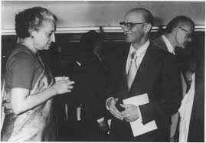
RECOMMENDED ACTION: DO NOT PLACE DIRTY LAUNDRY OR SMOKING GUNS
IN SUPPLEMENTAL FILES
WRITTEN BY: Oscar Kempthorne (1972), discussing:
OK with Indira Gandhi

Slide 25
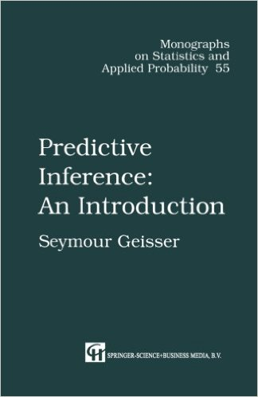
PREDICTION
GEYSSER (1993)
Heritability: unobservable
Breeding values: unobservable
Time to death (conditional on alive): unobservable
Prediction: statement about something yet-to-be observed, eventually observable

Slide 26
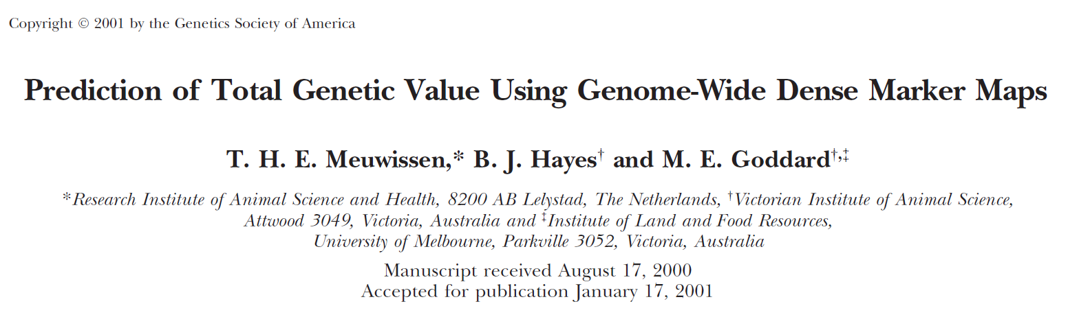
GENOMIC SELECTION: A DOMINANT RESEARCH AND DEVELOPMENT THEME
Bayes A, B, C, C-pi, D, Fast-B, L, R, RC, RS, TA, TB, TC, GBLUP, RKHS, NN…

Slide 27
RECENT ESTIMATES (GBLUP) OF GENETIC TRENDS IN DAIRY CATTLE
GARCIA-RUIZ, 2016. PNAS

Slide 28
The era of machine learning and artificial intelligence (largely non-parametric)

Slide 29
2013

Slide 30
ANIMAL+ PLANT BREEDERS WERE ALREADY DOING MACHINE LEARNING!

Slide 31
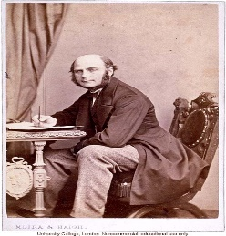
Machine
learning
BLUP is
a linear UA
2011
Neural networks
Data mining
Universal
approximators
Pattern
recognition
Cross-validation
designs
Kernel
methods
2006
2008
2000
1991
1993
“Gibbs
for pigs”
Random forest
algorithms
Sampling
methods
2011
Support vector
machines
Ensemble
Methods:
bagging
Ensemble
Methods:
boosting
Non-parametric
prediction
Bayesian
networks
2011
2014
2010
2006
2009

Slide 32
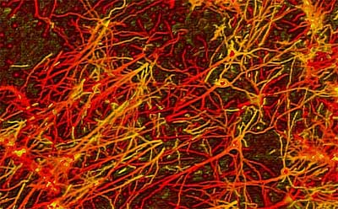
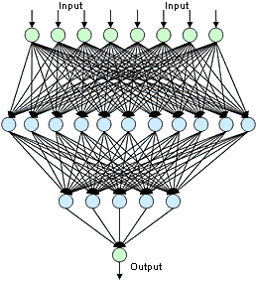
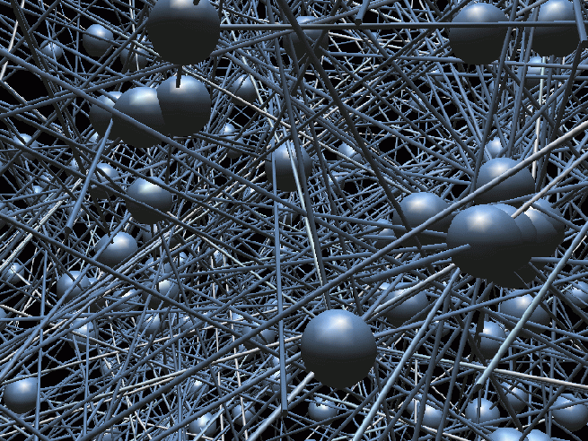
OUR EXPERIENCE WITH PARADIGM 3
More universal prediction machines:
A. Regularized Neural Networks

Slide 33
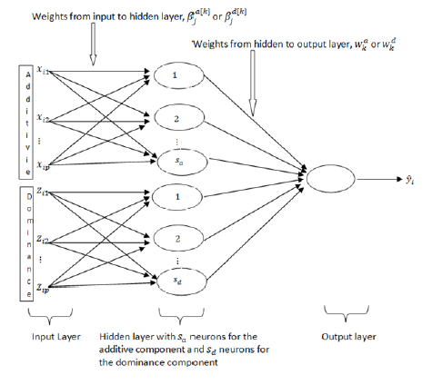
NETWORK DESIGN: THE POLI-PERCEPTRON (PPNN)
“Paulino Perez Neural Net”
Additive marker codes
(or relationships)
Dominance marker codes
(or relationships)
Including Additive and Dominance effects together in a NN.

Slide 34
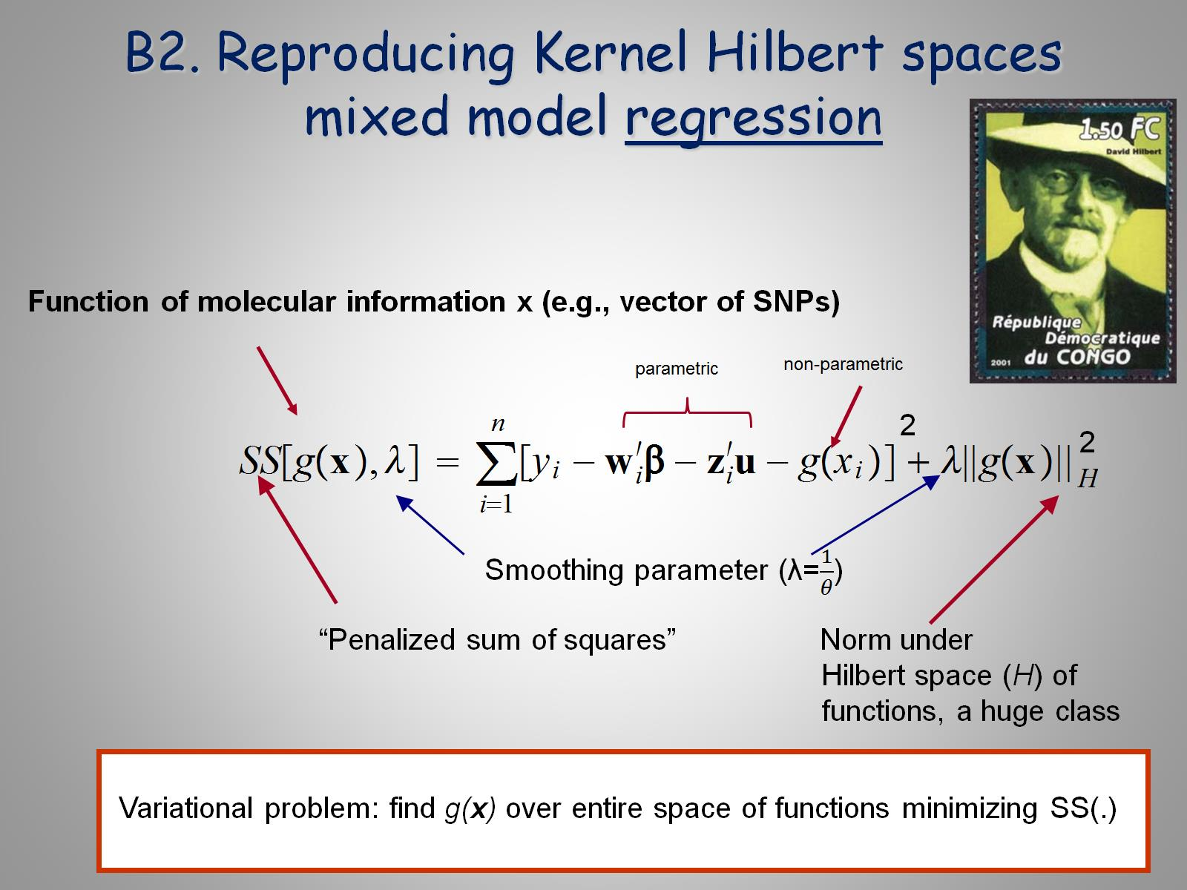

Slide 35
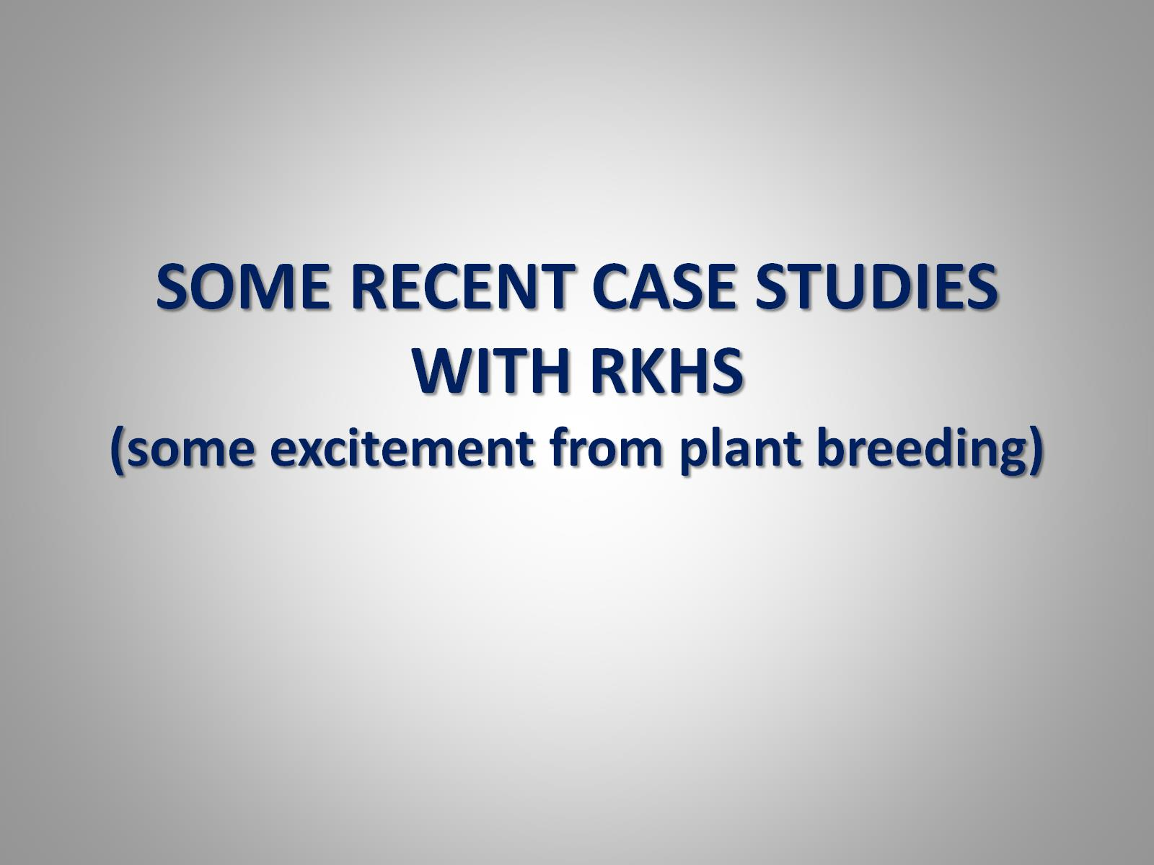
SOME RECENT CASE STUDIES WITH RKHS (some excitement from plant breeding)

Slide 36
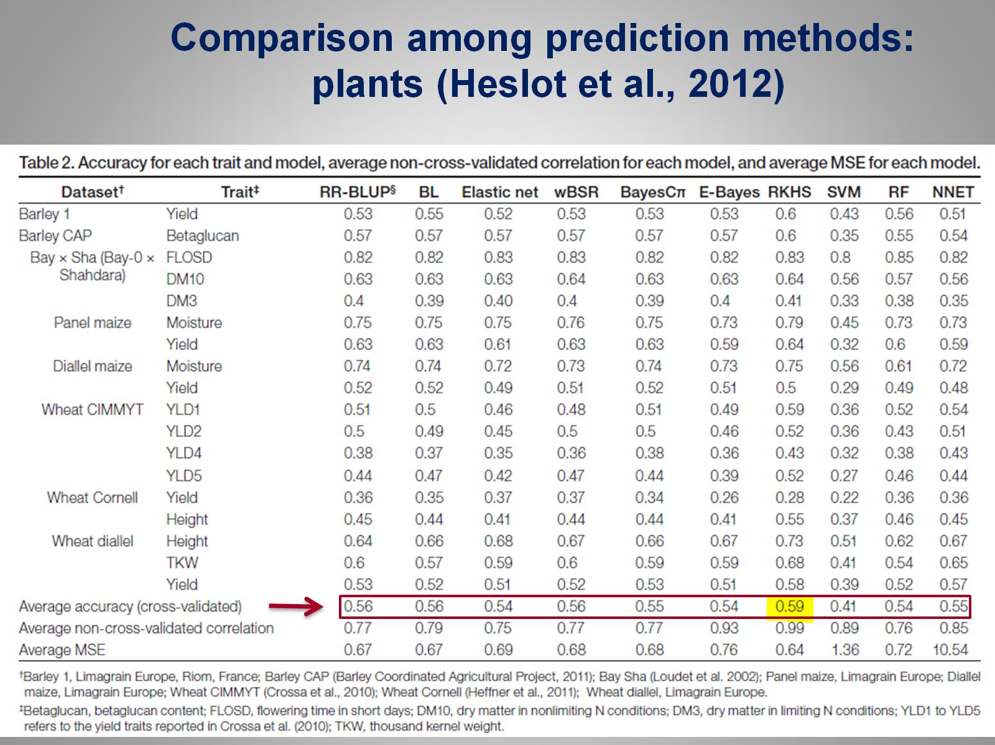

Slide 37
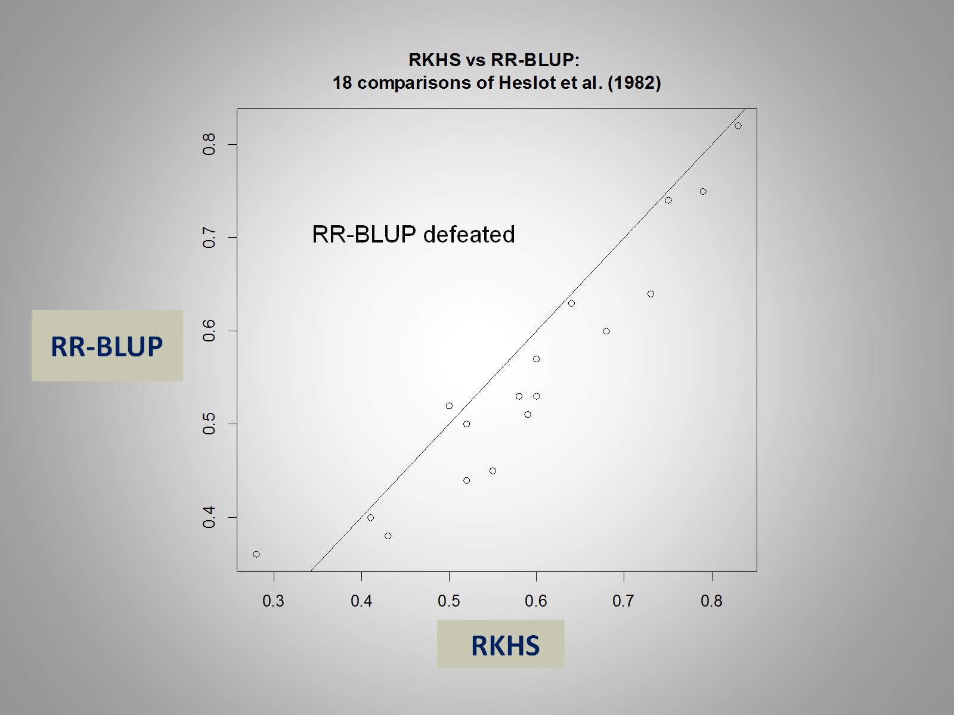

Slide 38
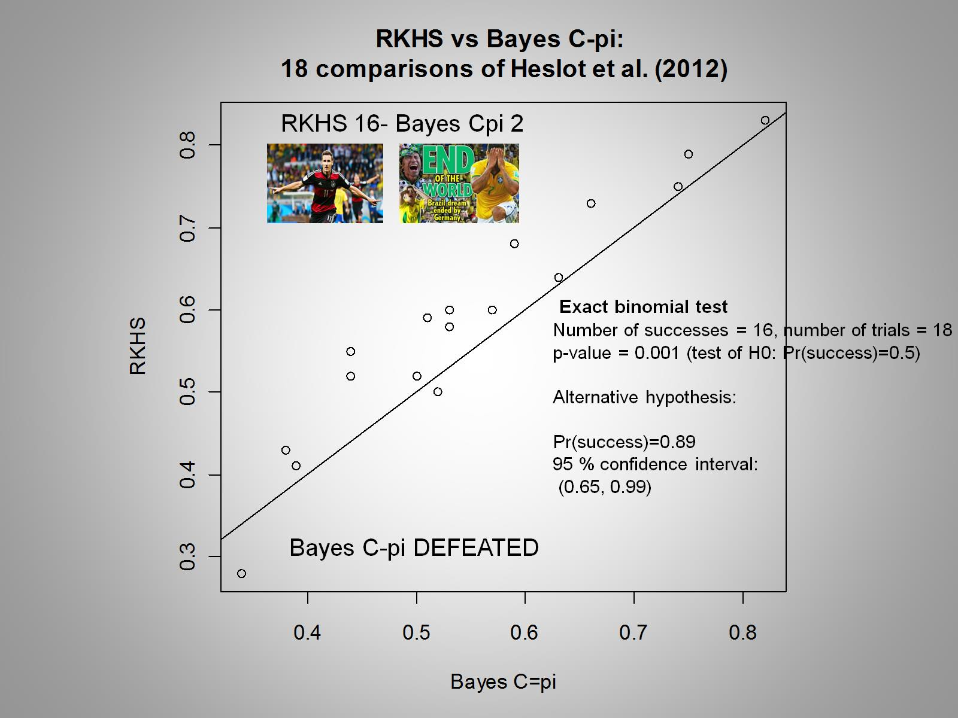

Slide 39

DOES MODEL AVERAGING HELP?
(in theory, MA expected
to improve predictions)
Line A
2,598 PB
46,855 SNPs

Slide 40
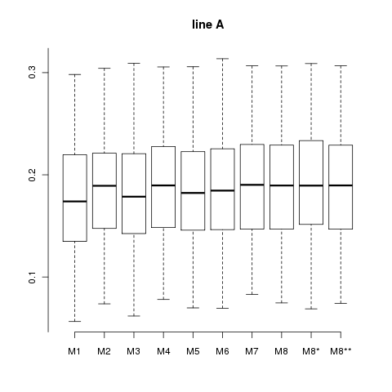
RKHS-KA-MA
Continued...
-50 random partitions: 90% of observations in training and 10% in testing
-Correlations between observed and predicted litter sizes
1-3 Single kernel
4-7 “multi-kernel”
Model averaging
8* Averaging using
PMSE in a validation set,
followed by testing
9 BMA
Distribution of correlations between observed and predicted phenotypes.
MULTI-KERNEL PREDICTIONS NOT WORSE THAN BMA; NOISY DATA

Slide 41
MULTI-OMICS

Slide 42
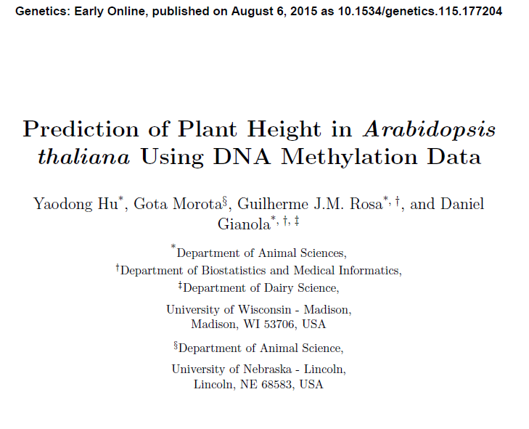

Slide 43
RKHS FOR GENOTYPE X ENVIRONMENT INTERACTION

Slide 44
NEW METHODS COMING…
The return of the neural networks…

Slide 45
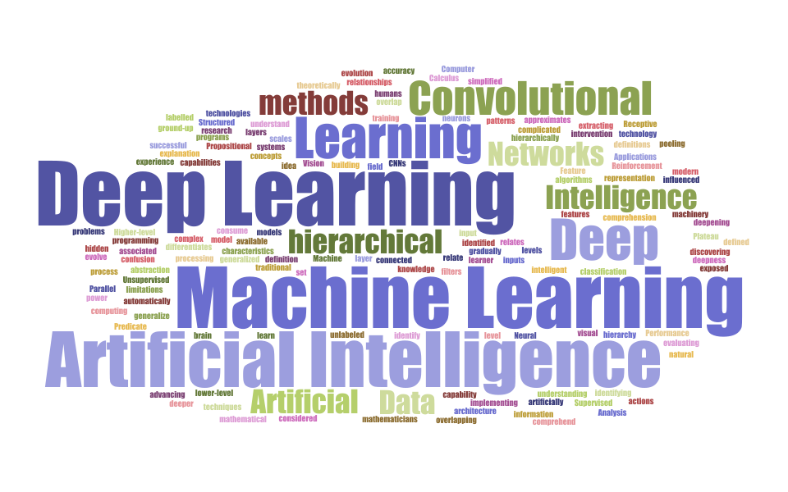


Slide 46
McDowell (2016) “Genomic selection with
Deep Neural Networks”.
MS Thesis, Iowa State University
[Bill Beavis, advisor]
6 PUBLICLY AVAILABLE
DATA SETS
RESULTS: NO CONCLUSIVE EVIDENCE OF SUPERIORITY OF NN or DNN

Slide 48
RESULTS: NO CONVINCING EVIDENCE OF SUPERIORITY OF DBN

Slide 50
Conclusions
Animal breeders have taken up statistical ideas rapidly. CRH instrumental and pioneering
Breeders also contributed to statistics as well: BLUP, REML, Bayesian modeling, Bayesian linear regression, genome-enabled prediction…

Slide 51
More Conclusions
Challenges to parametric methods posed by genomic, environmental, robotic information
Future: analytical shift? Semi-parametric and “machine learning” type techniques?
Quantitative genetics theory will continue guiding
animal and plant breeding programs, but it is not
suited for explanation of complex traits

